Slide 1
Smart aquarium with Maintenance and Monitoring through IoT Automation
BHMSHB HERATH
D/ENG/23/0086/ET
STREAM : ET
Proposal Presentation of Individual Design Project

Slide 2

Content of the Presentation
Problem Identification
Objectives
Literature Review
Market Survey
Target Audience
Specifications Of the Product
Components
System Design
Problems Encountered and Solutions
Cost Estimation
Time Plan
References

Slide 3

Problem Identification
Maintaining a healthy and stable environment in aquariums.
Frequent manual checks and adjustments are needed.
Manual monitoring of water parameters (temperature, pH, etc.) are often inconsistent.
Without real-time monitoring, problems with water quality can go unnoticed until they become severe.

Slide 4

Objectives
Monitor water temperature and pH levels
Develop a user friendly interface to track water quality metrics
Implement an Automated Feeding System
Integration with user interface

Slide 5

Literature Review
Smart Aquarium Automation
Smart aquariums use IoT and microcontrollers like ESP32 for automated control of feeding, lighting, and water quality. This improves remote monitoring, reducing manual maintenance efforts. [1], [2]
Water Quality Monitoring
Sensors like pH, temperature, and turbidity monitors help maintain stable aquatic conditions. Real-time analysis prevents water contamination and ensures fish health. [3], [4]

Slide 6
Lighting and Environmental Control
LED lighting systems optimize fish growth and tank aesthetics by simulating natural conditions. AI-driven control adjusts brightness based on time and fish behavior. [2], [5]
Water Circulation and Filtration Systems
Efficient water circulation and filtration systems ensure clean and oxygen-rich water for fish. Automated pumps and filtration mechanisms improve water quality and reduce maintenance.
Automated Feeding Systems
Automated feeders dispense food based on pre-set schedules or fish activity. This prevents overfeeding, ensuring proper nutrition and reducing waste buildup. [1], [3]

Slide 7
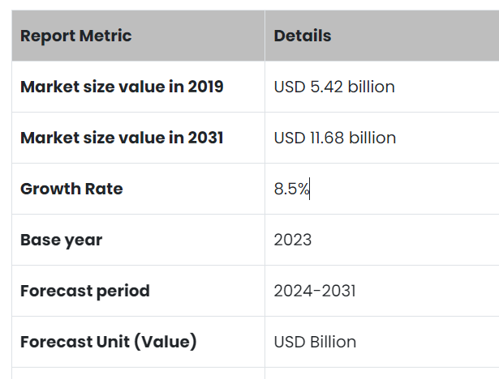
Target Audience
Aquarium hobbyists
Mini Aquarium owners
Busy Professionals
Source-“Aquarium Market Size, Share & Trends | Growth Report [2032],” Fortunebusinessinsights.com, 2024.
https://www.fortunebusinessinsights.com/aquarium-market-110692

Slide 8
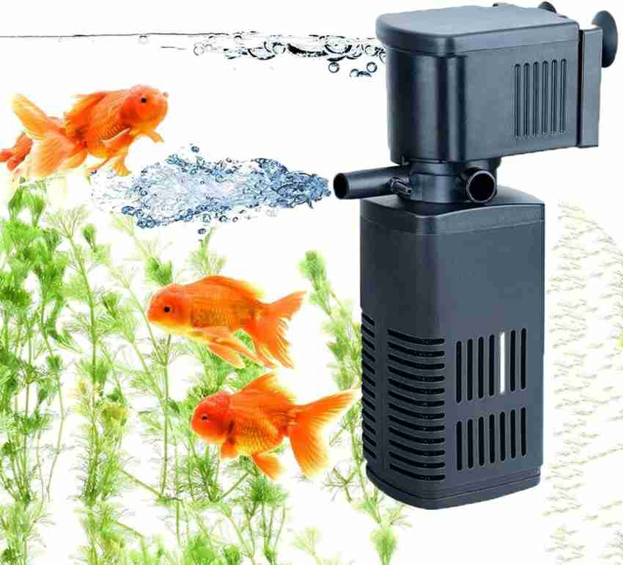
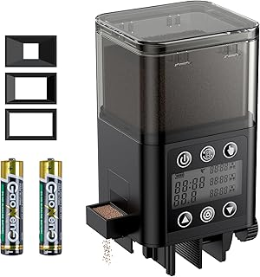
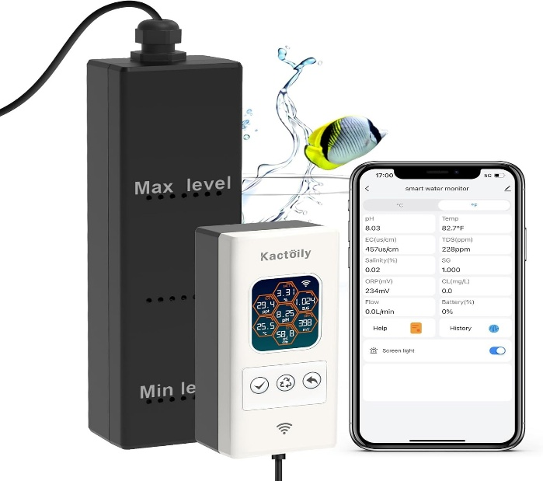
Market Survey
Kactoily Smart Aquarium Monitor
Price- $188.99
All-in-One Monitor: This versatile 7-in-1 aquarium pH monitor measures multiple water quality parameters including pH, TDS, EC, ORP, Specific Gravity, Salinity, and Temperature
Basic Sponge Filter
price range:
Small (10-30 gallons): $15 - $40
Medium (30-60 gallons): $40 - $70
Large (60+ gallons): $70 - $150+
Automatic Fish Feeder
Price- $19.99
Adjustable Feeding Amount
Adjustable Feeding Amount
Professional fish feeder with timer automatically dispenses food every day or at intervals (up to 4 days).

Slide 9

Specifications
Fully integrated system - semi automated feeding,
water quality monitoring,
lighting control,
temperature detection,
filtration
Cost effective
Movable

Slide 10
System Design
User
PH Level
PH Sensor
Temperature
ESP32
Mobile Application
TDS Level
Light
TDS Sensor
Water Level Monitoring
Relay
Module
Light Button
Temperature Sensor
Monitoring System
Feeder Motor
Motor Driver
12V Power Supply
Ultrasonic Sensor
Filter Motor
Buck converter

Slide 11
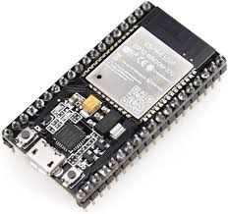
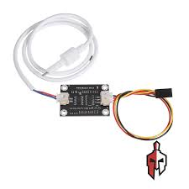
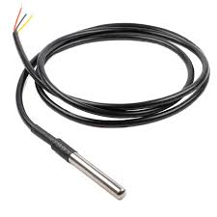
Components
ESP32 Development Board
Serves as the central controller to interface with sensors
TDS Sensor
Measures the total dissolved solids (TDS) in the water, providing insights into the water quality, which is important for the health of the aquarium inhabitants.
Temperature Sensor(DS18B20)
Monitors the water temperature in the aquarium, allowing for precise control

Slide 12
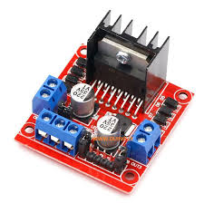
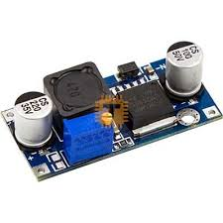
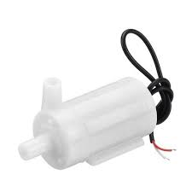
Motor Driver(L298N )
Used to control motors, such as filtration system motor and fish feeding motor
Step down module DC – DC(LM2596 )
Known as a step-down converter, is a DC-to-DC converter that reduces voltage while increasing current from its input to its output
submersible water pump
Used in filtration system
DC Voltage: 2.5-6V
Flow rate: 80-120L/H

Slide 13
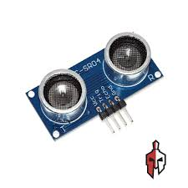
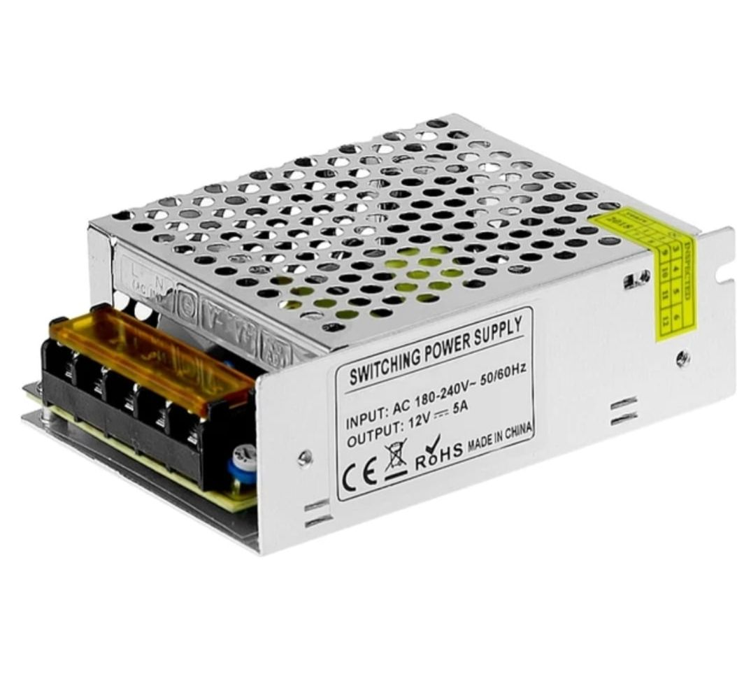
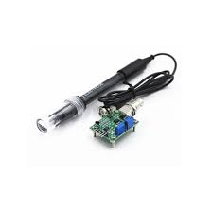
Ultrasonic sensor
Used to read the water levels
12V 5A AC TO DC Universal Regulator
providing the necessary power for components.
ph Sensor
Measures the pH level of the water.
Working current: 5-10mA
The detection concentration range: PH 0-14

Slide 14
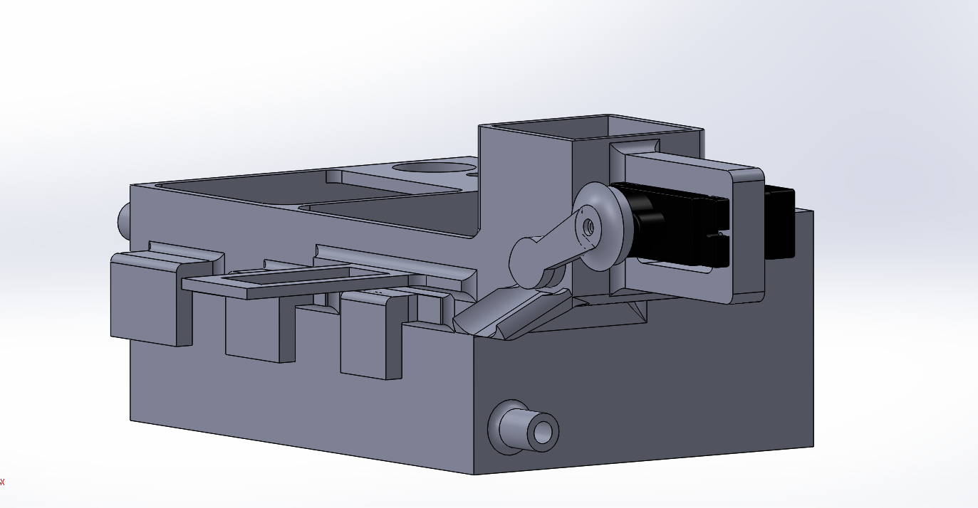
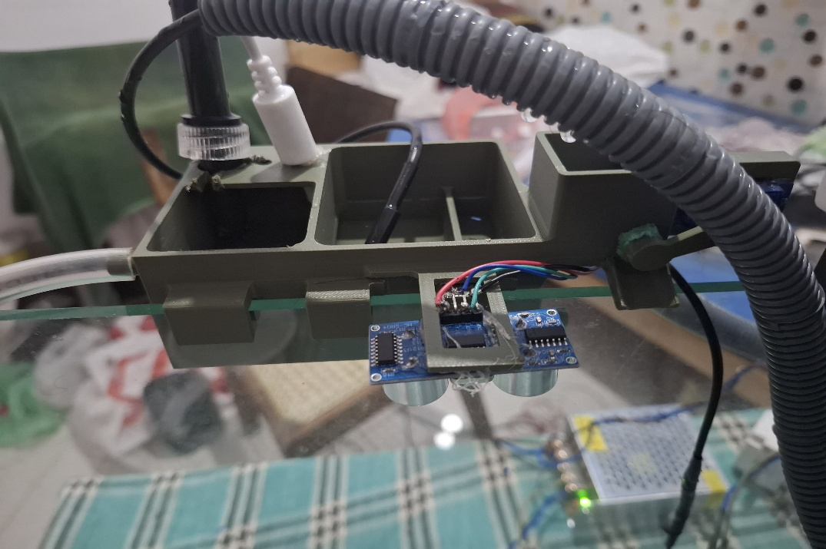

Design of the Filter(prototype)

Slide 15
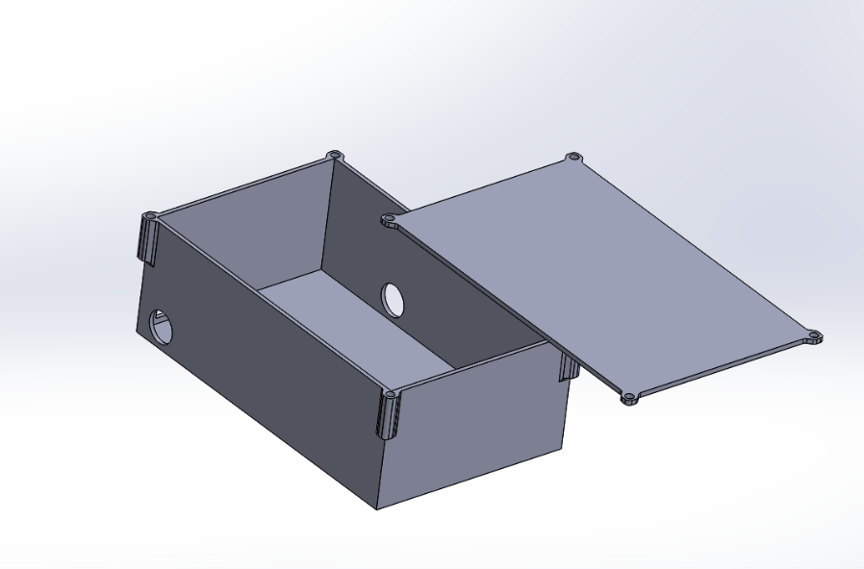
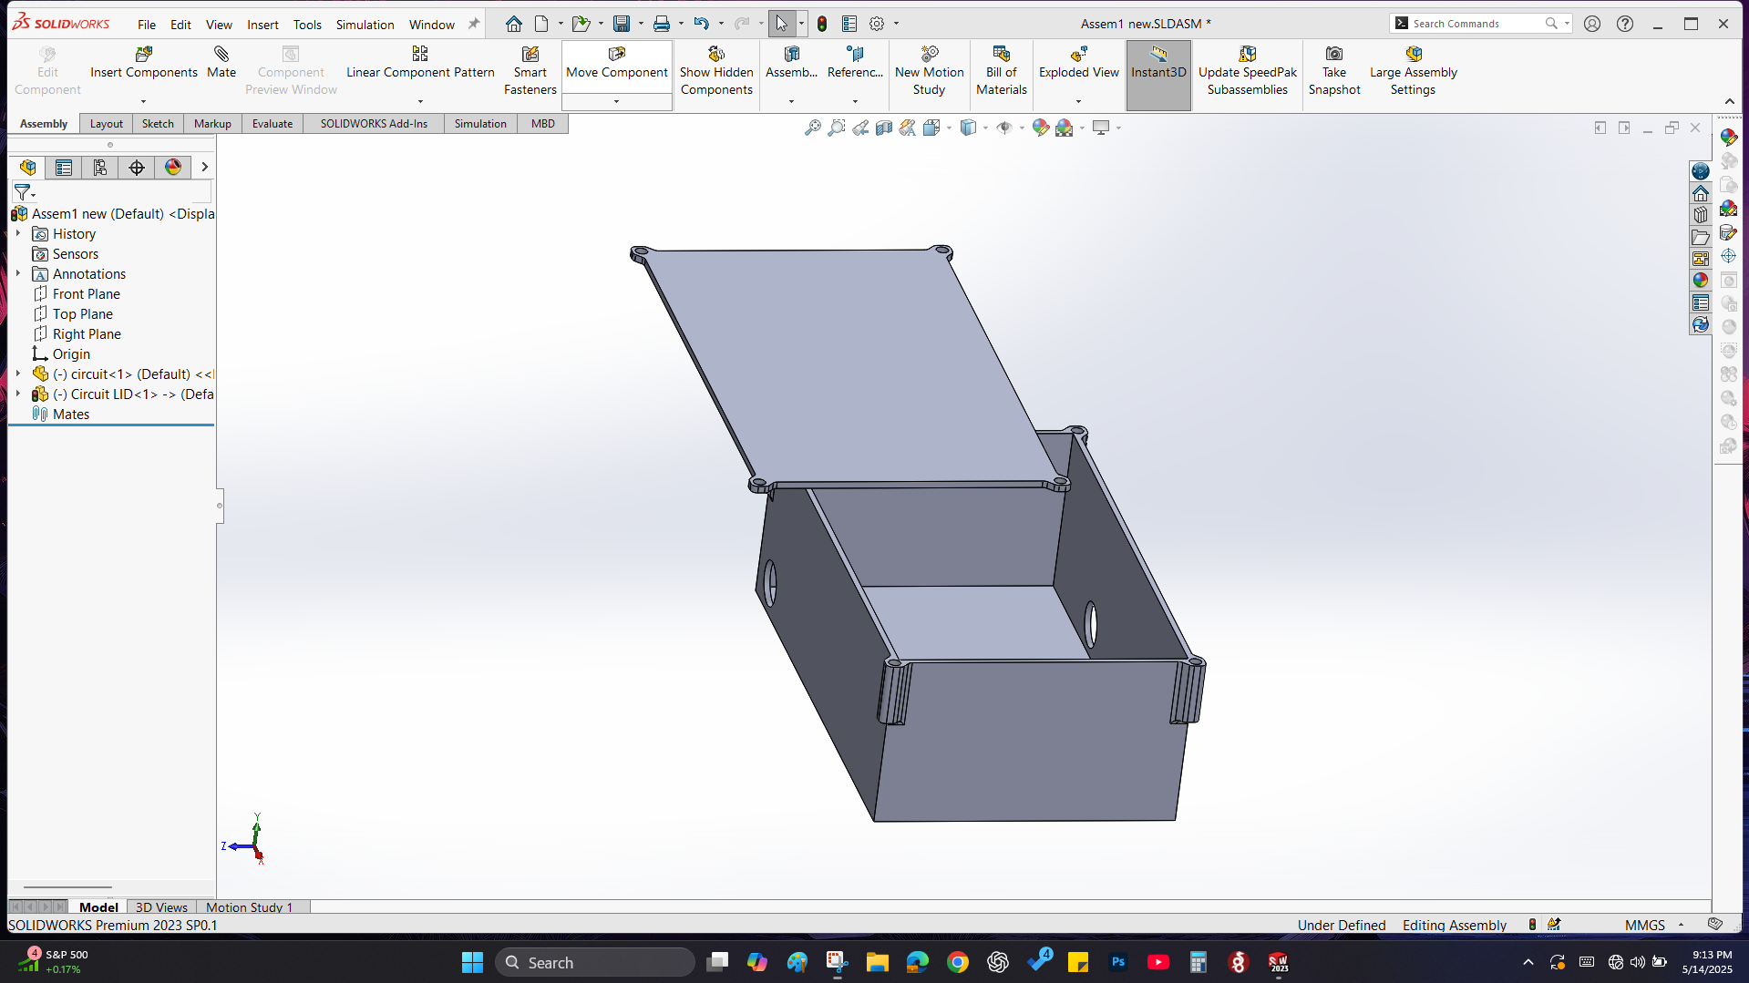
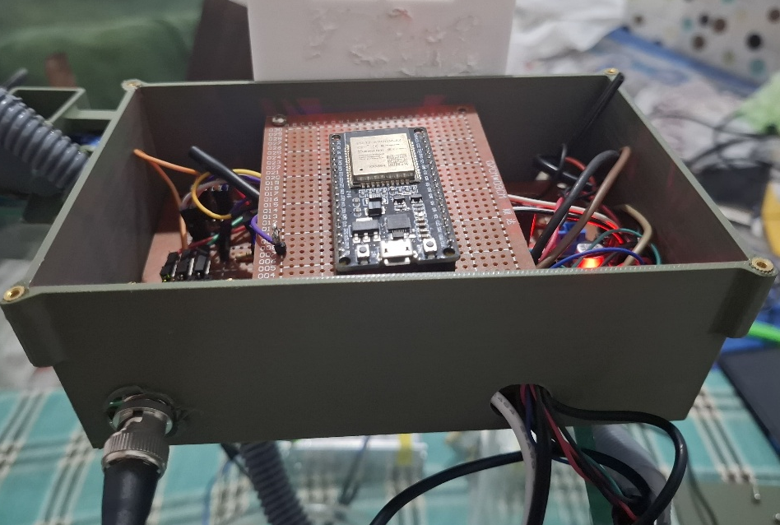
Design of the Enclosure Box

Slide 16
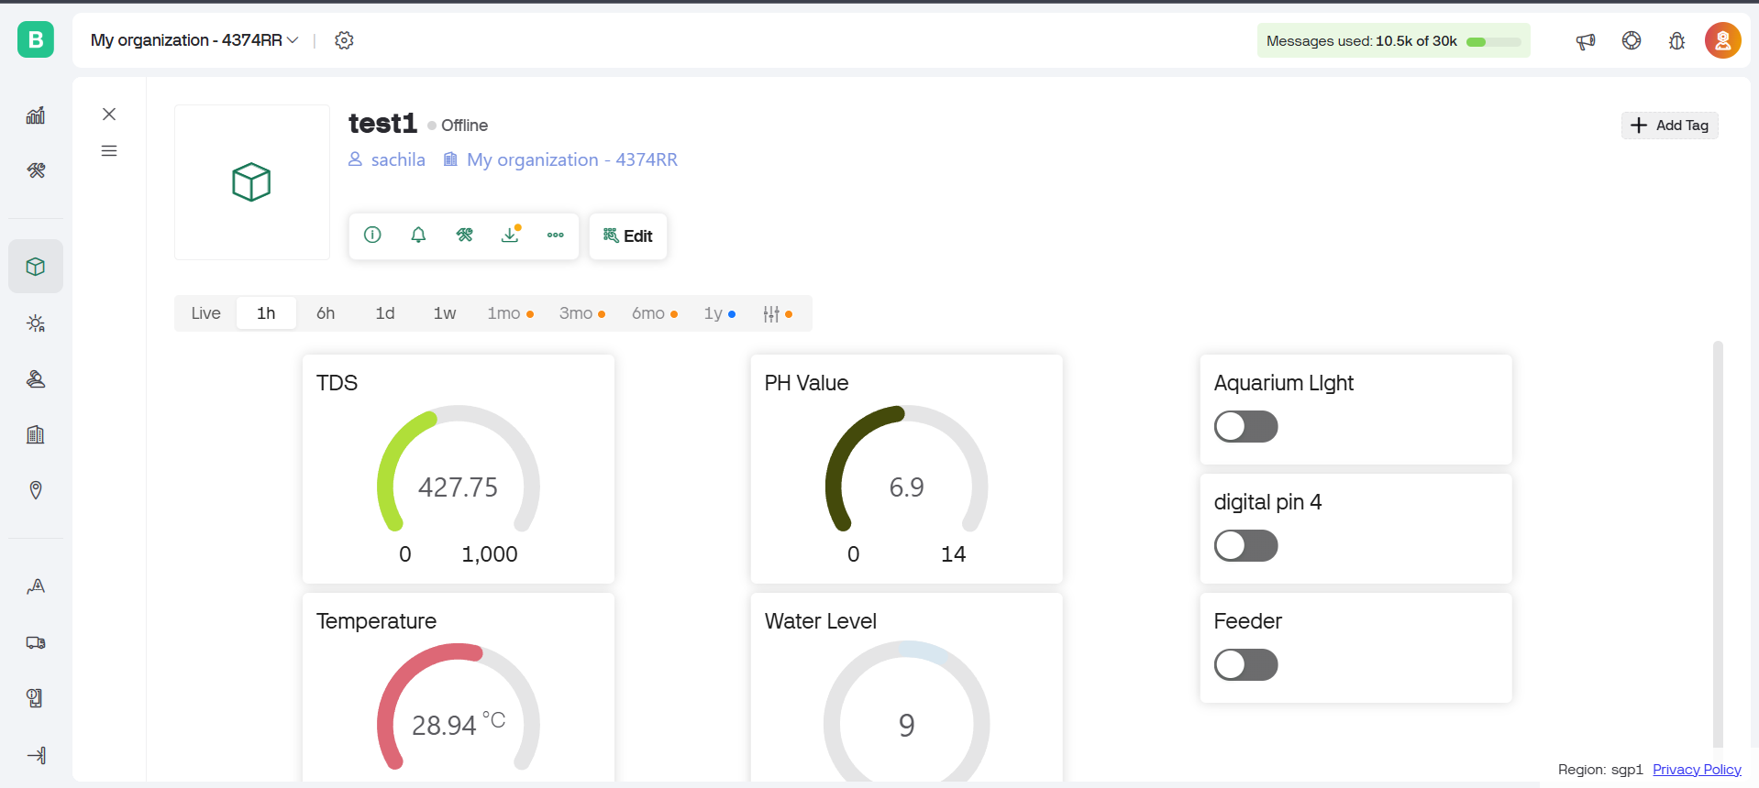
Results and Discussion
User Interface:

Slide 17
Limitations
Limited Water Quality factors: Other critical factors like ammonia, nitrite, nitrate, and dissolved oxygen are not monitored by the existing system, which only keeps track of temperature, pH, TDS, and water level.
Requirement for Manual Calibration: In order to preserve accuracy, sensors especially the pH sensor need to be manually calibrated on a regular basis. This still requires some user involvement.
Fixed Feeding Mechanism: As fish populations fluctuate, the existing feeding system may result in underfeeding or overfeeding because it dispenses fixed amounts of food and is not responsive to fish activity or growth.
Power Dependency: Without a backup power system, the system is susceptible to power outages because it depends on a constant power source

Slide 18
Problems Encountered and Solutions
Problem | Details | Solution
Port not detected in Arduino IDE | ESP32 wasn’t appearing in the available ports list, causing upload failures. | Reinstall the CP210x drivers
No DS18B20 Sensor Detected | The sensor is not found when running detection code. | Try a different GPIO pin (4, 5, 14, or 15) and enable INPUT_PULLUP. Check if the sensor works with the microcontroller.
Unstable Wi-Fi connectivity | Frequent disconnections from the local network during testing. | Updated the ESP32 firmware for better performance.
ESP32 fails to connect to Blynk | ESP32 continuously tries to connect but shows a "Login timeout" message. | Verify Wi-Fi SSID and password. Ensure the network is 2.4 GHz.

Slide 19
Cost Estimation
Component | Price(Rs.)
ph Sensor | 5,700
DS18B20 Temperature Sensor | 230
Analog TDS Sensor | 2,900
L298N Motor Driver | 460
3D Print | 7300
Resistors /Cables/LED/Breadboard | 770
ESP32 Development Board | 1600
Motors | 400
Buck Converter | 140
Power Supply | 1000
Fish Tank | 2000
Total = RS. 22,500

Slide 20
Time Plan
 | August |  | September |  | October |  | November |  | December
 | Week 1 | Week 2 | Week 3 | Week 4 | Week 1 | Week 2 | Week 3 | Week 4 | Week 1 | Week 2 | Week 3 | Week 4
Research and Analysis | `
System Design
Component Selection
System Development
Prototype Development
Testing
Implementation
Evaluation
January |  |  |  | February |  |  |  | March |  |  |  | April
Week 1 | Week 2 | Week 3 | Week 4 | Week 1 | Week 2 | Week 3 | Week 4 | Week 1 | Week 2 | Week 3 | Week 4
`

Slide 21
References
[1] A. Kumar and B. Singh, "IoT-Based Smart Aquarium: A Survey," IEEE Internet of Things Journal, vol. 8, no. 3, pp. 2504–2515, Mar. 2021.
[12] K. Patel et al., "Smart Aquaponics: Integrating IoT for Efficient Aquaculture," IEEE Internet of Things Magazine, vol. 4, no. 1, pp. 40–48, Mar. 2022.
[3] J. Smith et al., "Real-Time Water Quality Monitoring Using IoT," IEEE Sensors Journal, vol. 19, no. 5, pp. 1832–1840, Feb. 2022.
[4] L. Zhang and P. Chen, "IoT-Based Water Quality Analysis for Smart Aquaculture," IEEE Access, vol. 11, pp. 9052–9065, Mar. 2023.
[5] D. Kim and Y. Park, "Smart Aquarium Lighting Control with IoT and AI," IEEE Internet of Things Journal, vol. 9, no. 7, pp. 5750–5760, Nov. 2022.

Slide 22
Thank You!

